Slide 1
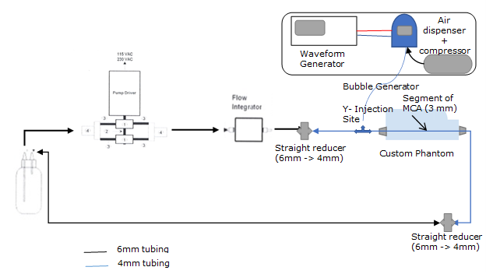
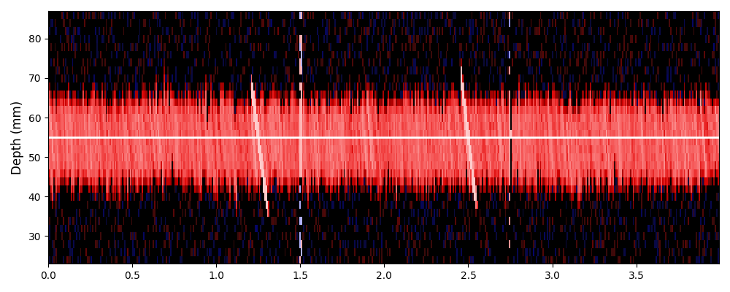
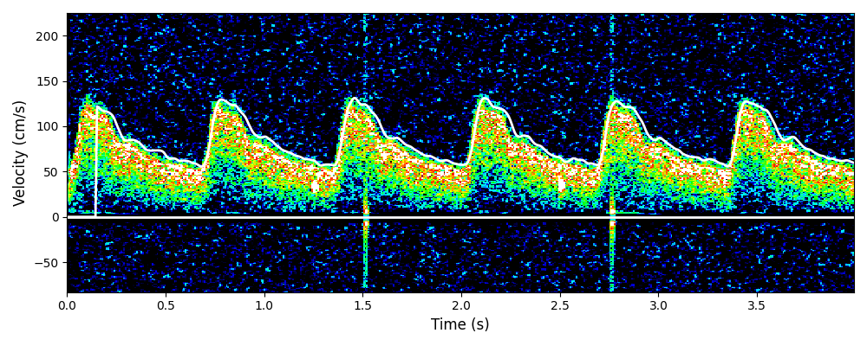
Deep Learning Algorithm For Grading Right-to-Left Shunts
Corey M. Thibeault¹ │ Aly Ung¹ │ Alex Zhao¹ │ Amber Y. Dorn¹ │David Dayanim¹│ Shankar Radhakrishnan¹ │ Robert Hamilton¹
¹ NovaSIgnal Corp. Los Angeles, CA USA
Introduction
Methods
results
The utility of transcranial Doppler ultrasound (TCD) in the identification of right-to-left shunts (RLS) is well established.
A TCD bubble study can be used to evaluate the presence and severity of RLS based upon the frequency and timing of embolic signals representing microbubbles.
However, interpretation of the results can be a diagnostic barrier for naive users.
ASG Algorithm Development
The ASG algorithm showed an overall accuracy of 97%.
ASG employs a stereotypical image classification network configuration.
The bottom of the network consists of convolutional layers of increasing filter sizes.
The top two layers are fully connected dense layers of 256 neurons each.
Finally, the network output consists of a three-neuron dense layer with softmax activation
Shunt Severity | Precision | Recall | F1-Score | Total
Negative Shunt | 0.97 | 0.99 | 0.98 | n=220
Minor Shunt | 0.96 | 0.87 | 0.91 | n=86
Significant Shunt | 0.97 | 0.99 | 0.98 | n=177
Aims
Outputs
In this work we demonstrate a method for simplifying this process, by employing deep learning techniques to automate the interpretation of TCD bubble studies and the grading of an RLS called auto shunt grade (ASG).
Input
33x7500
Dense Layers
Convolution
Layers
Table 1. Results of ASG algorithm for each shunt severity category.
Methods
Simulations
Figure 2. Composition and layering of the ASG algorithm.
conclusions
Training data was created through computational simulation of the Doppler shifted ultrasound response to blood cells and gaseous emboli in pulsatile flow.
Work began with the simplest case of laminar, constant, uniform flow, before relaxing assumptions one at a time to move to more complex cases.
Three grades of RLS were defined based on the number of emboli counted unilaterally (Negative: no bubbles, Minor: 1-10 bubbles, Significant: >10 bubbles).
The data was created in 60-second Power M-mode segments with 33 depths.
A total of 100,284 segments were generated for training (80%) and validation (20%).
Data Collection and Algorithm Testing
ASG provides both naive and experienced users more confidence when identifying a right-to-left shunt.
Furthermore, the high sensitivity for the significant grade illustrates that clinically meaningful shunts are seldom missed by the ASG algorithm.
ASG represents an objective method for the evaluation of RLS using TCD.
For testing, healthy subjects were scanned with the NovaGuide 2 Intelligent Ultrasound for 60 seconds bilaterally (n=110, 39.7±14.7 years, 40% female).
This dataset was then enriched using segments from a flow-phantom with automatic bubble injection.
Figure 1. Example simulation data generated for training and validation of ASG.
Questions?
corey@novasignal.com
Figure 3. Schematic of flow-phantom setup used to generate segments to enrich dataset.
For Research & Investigational Use Only. Not for Commercial Use.

